Slide 1
Intermediate Proposal: DBMS in Booking.com
15146325 Wonho Choi
16102273 Jihye Ryu
16102280 Heejin Son
17102054 Ingyun Ahn

Slide 2
Contents
1. Basic Idea
2. System overview
3. Detailed Functionalities
4. Intermediate results
5. Project Plan

Slide 3
Basic Idea
DATASET
USERS_RATE
JOURNEY_TYPE
COMMENT_DATE
COUNTRY
CITY
ACCOMMODATION_TYPE
FINAL TARGET
Recommend
the BEST place to travel,
the MOST popular accommodation,
and
the MOST common type of journey.

Slide 4
System Overview
Please enter the month you want to travel ! :-)
“ ”
April

Slide 5
System Overview
BEST city to travel
in APRIL
MOST popular accommodation
In Boracay
TOP 3
1. Philippine Boracay
2. Japan Osaka
3. Netherland Amsterdam
TOP 3
1. Hotel
2. Resort
3. Guest House
BEST city to travel
in APRIL
TOP 3
1. Philippine Boracay
2. Japan Osaka
3. Netherland Amsterdam
MOST common type of journey
In Boracay
…
TOP 3
1. Couple
2. Friend
3. Family

Slide 6
System Overview
MOST popular accommodation
In Philippine Boracay
BEST city to travel
in APRIL
MOST popular accommodation
In Boracay
TOP 3
1. Hotel
2. Resort
3. Guest House
TOP 3
1. Philippine Boracay
2. Japan Osaka
3. Netherland Amsterdam
TOP 3
1. Hotel
2. Resort
3. Guest House
MOST common type of journey
In Boracay
…
TOP 3
1. Couple
2. Friend
3. Family
MOST popular accommodation
In Japan Osaka
TOP 3
1. Hotel
2. Guest House
3. Hostel
…

Slide 7
System Overview
MOST common type of journey
In Philippine Boracay
BEST city to travel
in APRIL
MOST popular accommodation
In Boracay
TOP 3
1. Couple
2. Friend
3. Family
TOP 3
1. Philippine Boracay
2. Japan Osaka
3. Netherland Amsterdam
TOP 3
1. Hotel
2. Resort
3. Guest House
MOST common type of journey
In Boracay
…
TOP 3
1. Couple
2. Friend
3. Family
MOST common type of journey
In Japan Osaka
TOP 3
1. Friend
2. Business
3. Family
…

Slide 8
Detailed Functionalities
Users can input the ‘Month’ when they want to travel.
Users can get the top 3 ranked popular city in that period.
Users can get recommendation about the most popular type of accommodation in the top 3 city.
Users can get recommendation about the most common type of journey in the top 3 city.

Slide 9
Intermediate Results
ACCOMMODATION
ACCOMMODATION_ID (PK)
ACCOMMODATION_NAME
ACCOMMODATION_TYPE
COUNTRY
CITY
USERS_RATE
COMMENT
COMMENT_ID(PK)
COMMENT_DATE
JOURNEY_TYPE
ACCOMMODATION_ID (FK)

Slide 10
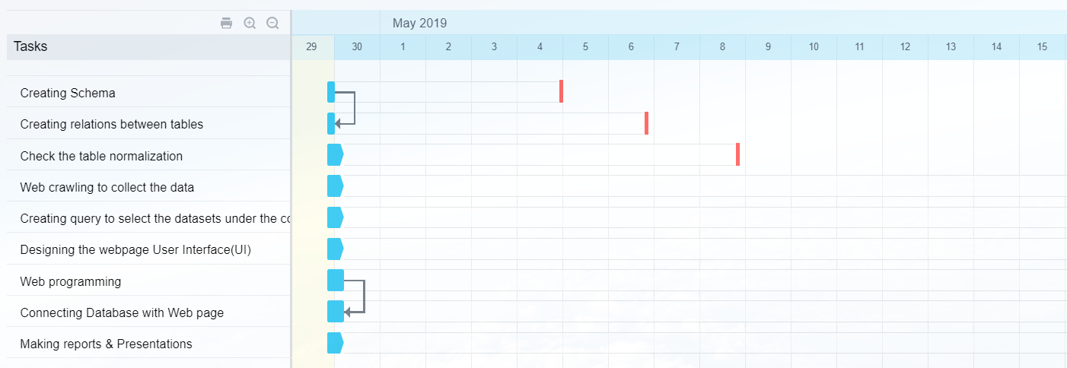
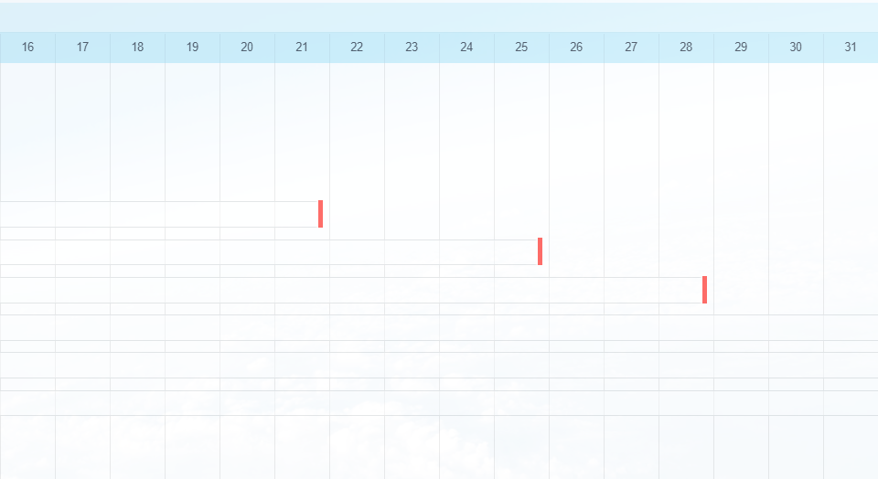
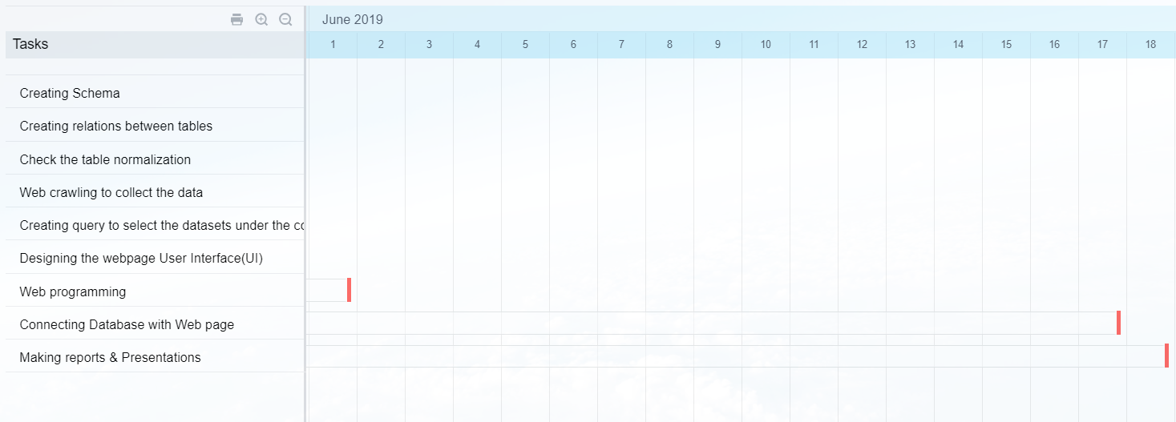
Project plan
Project plan using Bitrix 24

Slide 11
Thank you

